Slide 1
Build Management
Lecturer: Ngo Huy Bien
Software Engineering Department
Faculty of Information Technology
VNUHCM - University of Science
Ho Chi Minh City, Vietnam
nhbien@fit.hcmus.edu.vn

Slide 2

Objectives
To implement continuous integration.

Slide 3

Contents
Build Automation

Slide 4

References
Jez Humble and David Farley (2010). Continuous Delivery. Addison Wesley.
Paul M. Duvall et al. (2007). Continuous Integration Improving Software Quality and Reducing Risk. Addison-Wesley.

Slide 5

Software Build
On-Demand
Scheduled
Release Build
Stage Build
Integration Build
Private Build
Software Build is the combination of the correct versions of software configuration items, using the appropriate configuration data, into an executable program for delivery to a customer or other recipient, such as the testing activity.

Slide 6

Why Software Build? [1]
Software delivers no revenue until it is in the hands of its users.
Satisfying the customer through early and continuous delivery of valuable software.
Problems should be found early when they are easy to fix, and associated risks are well understood.
Reducing the time and risks associated with delivering new versions of your software to users.
How long would it take your organization to deploy a change that involves just one single line of code?
Do you do this on a repeatable, reliable basis?

Slide 7
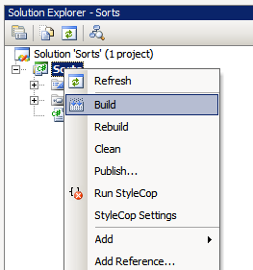
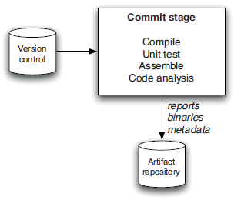
Building Software
Source Code, Documents, Data, Build Script
Build Tool
Software Build

Slide 8
Build Tools
Apache Ant. https://ant.apache.org/
NAnt. https://nant.sourceforge.net/
MSBuild. https://github.com/dotnet/msbuild
Apache Maven. https://maven.apache.org/what-is-maven.html
Gradle. https://gradle.org/

Slide 9
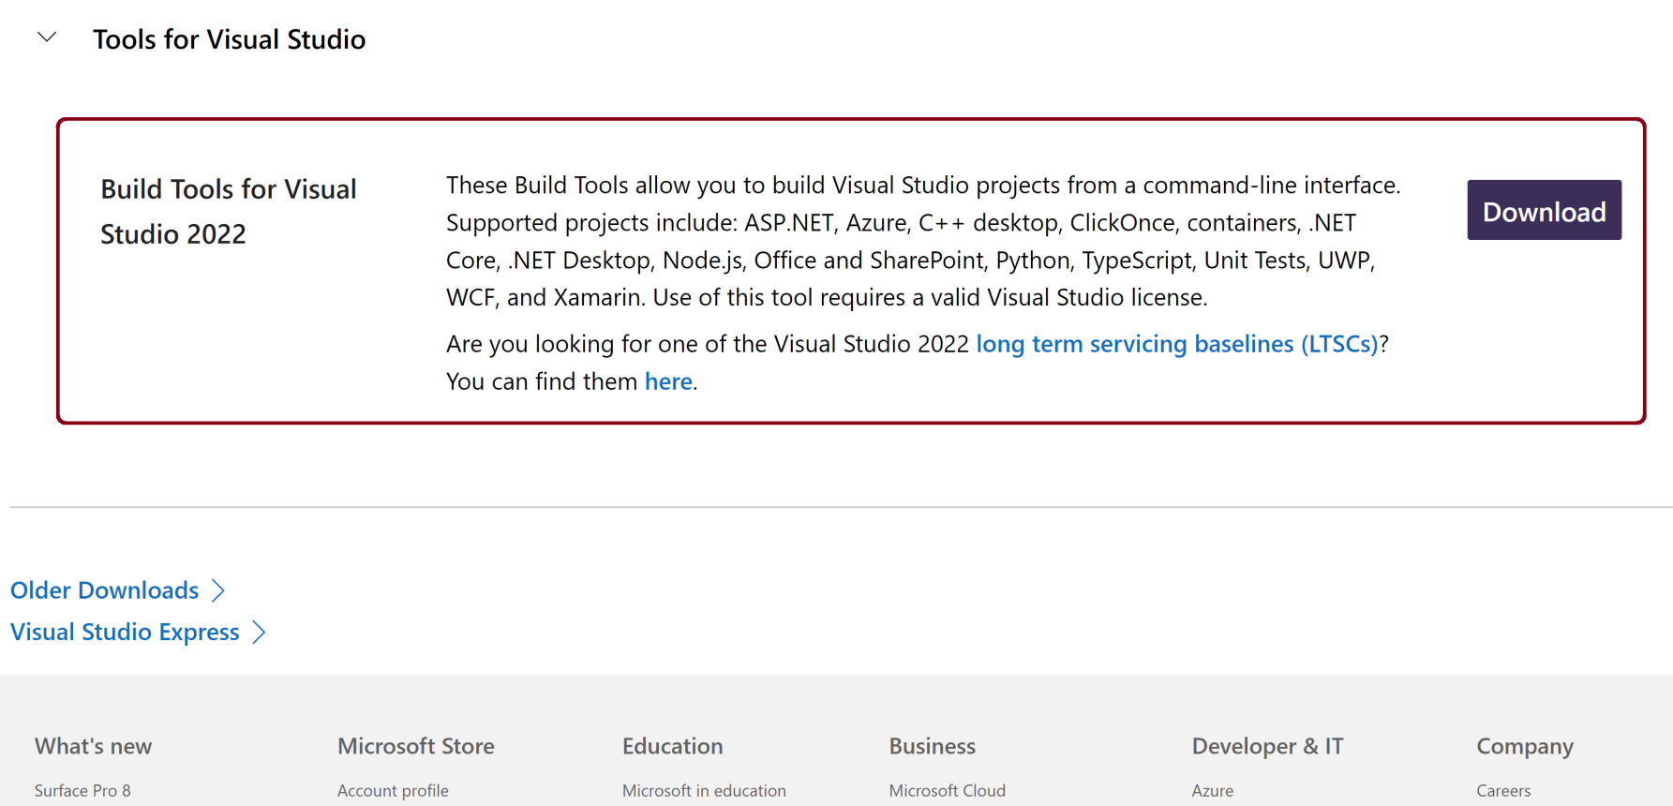
1. Download Build Tools for Visual Studio 2022
https://visualstudio.microsoft.com/downloads/?q=build+tools
Scroll down to the bottom of the page.

Slide 10
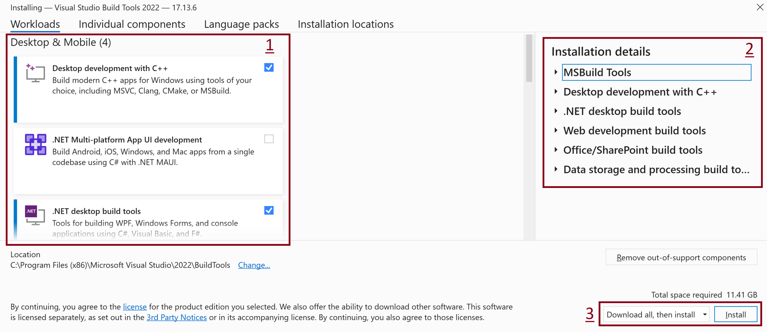
2. Select Workloads

Slide 11
3. Select a MSBuild.exe Location
Build Tools MSBuild.exe Location: C:\Program Files (x86)\Microsoft Visual Studio\2022\BuildTools\MSBuild\Current\Bin
C:\Program Files\Microsoft Visual Studio\2022\Professional\Msbuild\Current\Bin

Slide 12
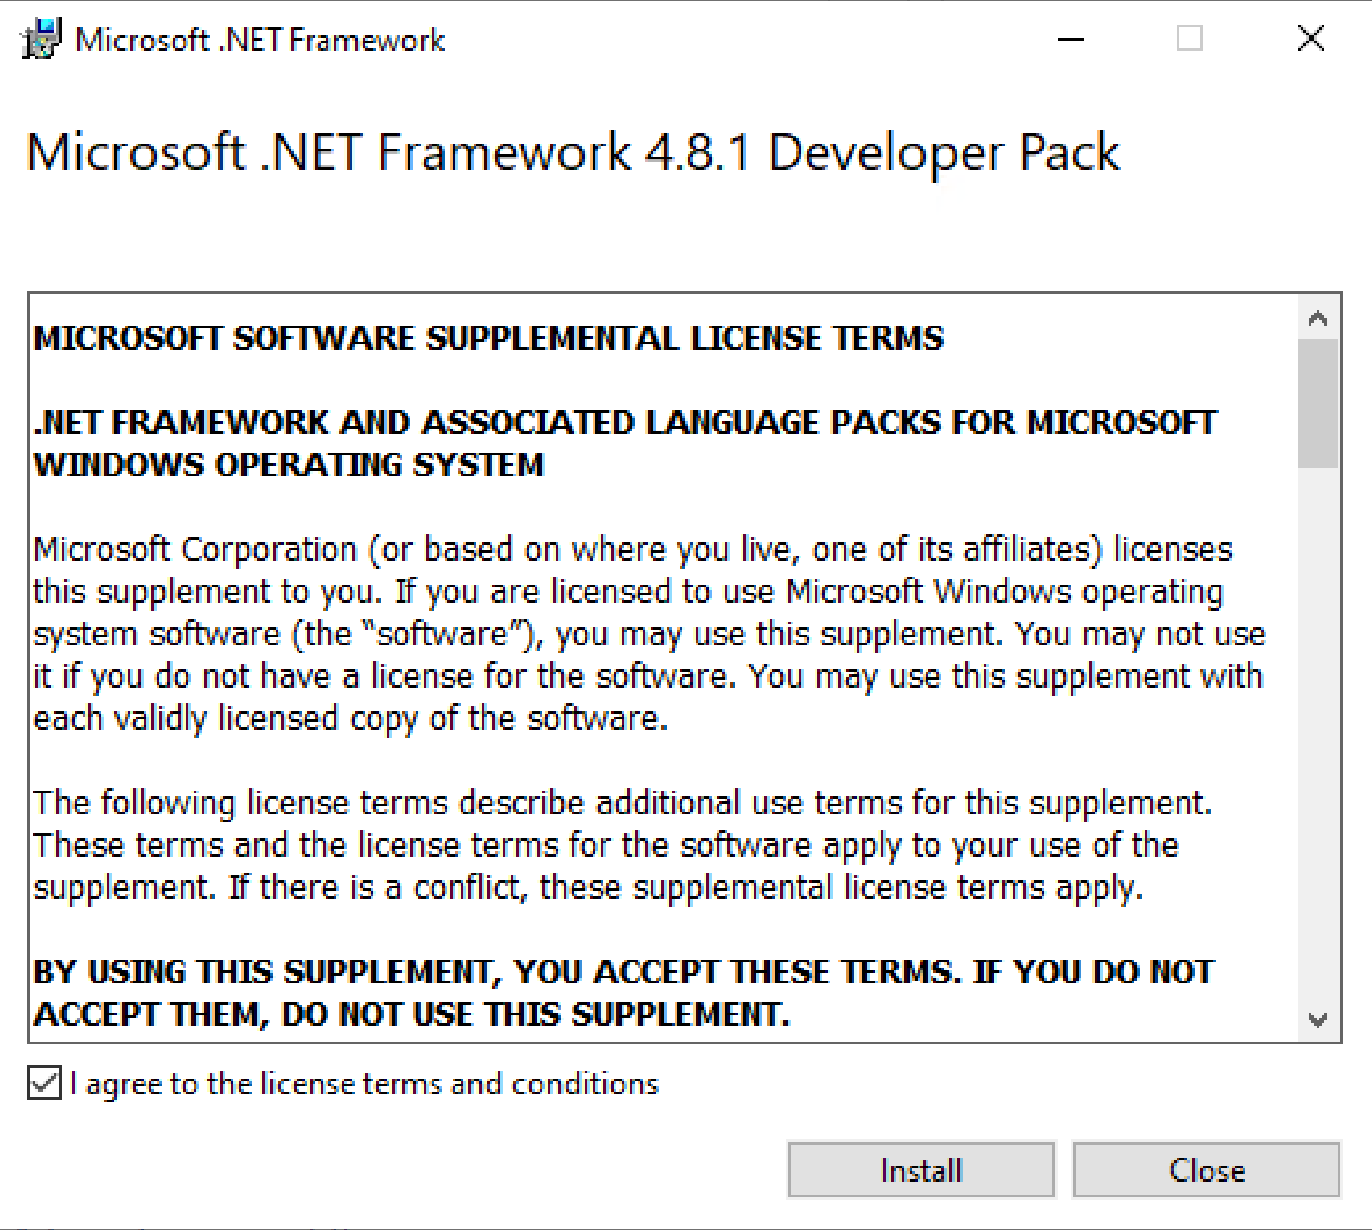
4. Install .NET SDKs for Visual Studio
https://dotnet.microsoft.com/en-us/download/visual-studio-sdks?cid=msbuild-developerpacks

Slide 13
4. Build a .NET Project
"C:\Program Files\Microsoft Visual Studio\2022\Professional\Msbuild\Current\Bin\MSBuild.exe" "../MySolution.sln" -restore -p:RestorePackagesConfig=true

Slide 14
5. Log Build Errors to a File
# Execute the command below to export errors to the Build.log file.
"C:\Program Files (x86)\Microsoft Visual Studio\2022\BuildTools\MSBuild\Current\Bin\MSBuild.exe" /property:Configuration=Release "YourSolution.sln" -restore -p:RestorePackagesConfig=true > Build.log
Open the Build.log file and search for "errors" text.

Slide 15
6. Hide Build Warnings
# Execute the command below to hide warnings and normal messages, but still show the final build result summary, including "Build succeeded" or "Build FAILED."
"C:\Program Files\Microsoft Visual Studio\2022\Professional\Msbuild\Current\Bin\MSBuild.exe" "./MySolution.sln" -restore -p:RestorePackagesConfig=true -p:StopOnFirstFailure=true /clp:Summary;ErrorsOnly

Slide 16


Slide 17
Continuous Integration [2]
Get latest source code
Develop your feature
Make a build on your machine
Run automated tests
Commit your code
Make a build on integration machine

Slide 18
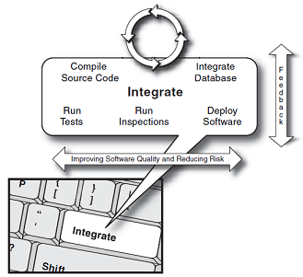
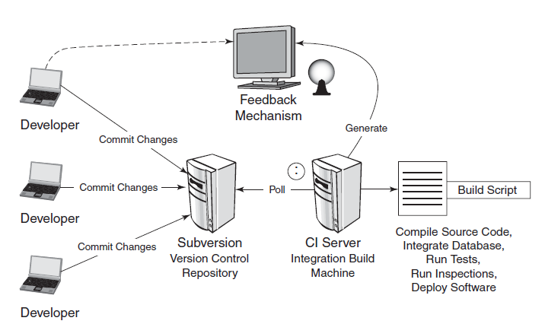
Continous Integration System

Slide 19
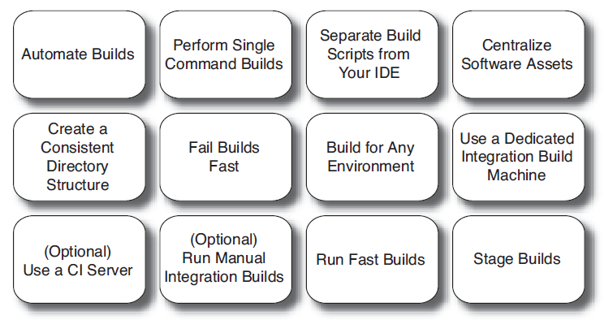
Building Software at Every Change

Slide 20
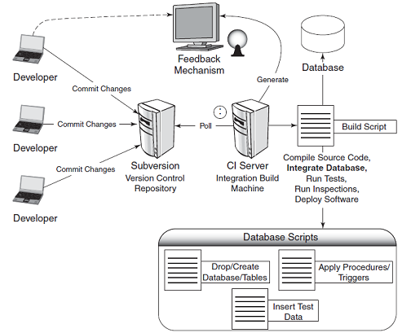
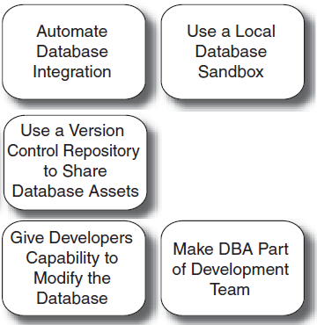
Continuous Database Integration

Slide 21
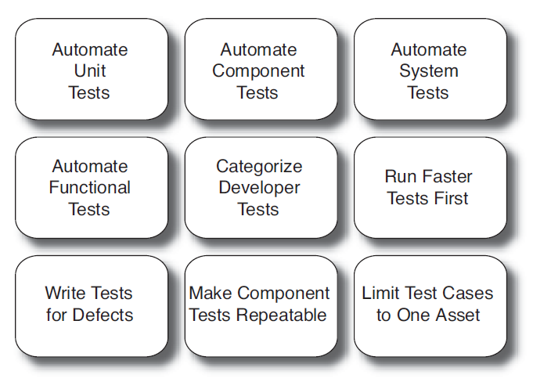
Continuous Testing

Slide 22
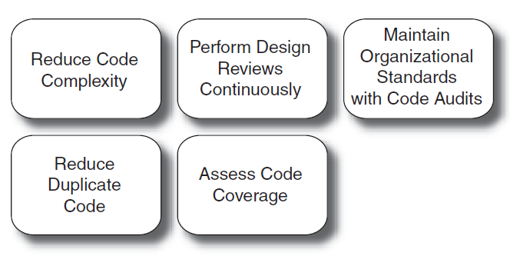
Continuous Inspection

Slide 23
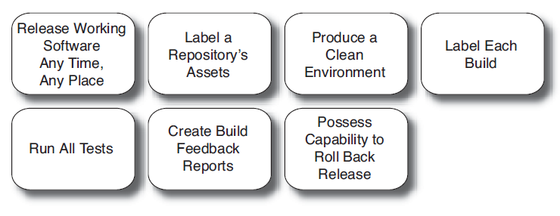
Continuous Deployment

Slide 24
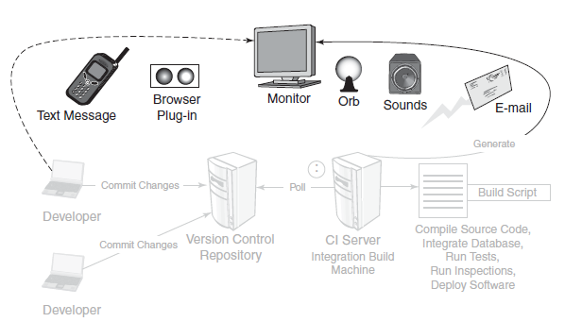
Continuous Feedback

Slide 25
Benefits/Threats
Benefits
Reduce risks
Easier to find and remove bugs
Threats
Managing problem areas
Builds are always up to date
A managed process

Slide 27
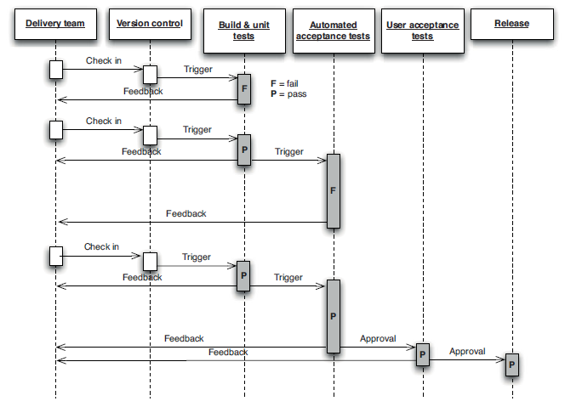
Deployment Pipeline [1]
A deployment pipeline is an automated manifestation of your process for getting software from version control into the hands of your users.

Slide 28
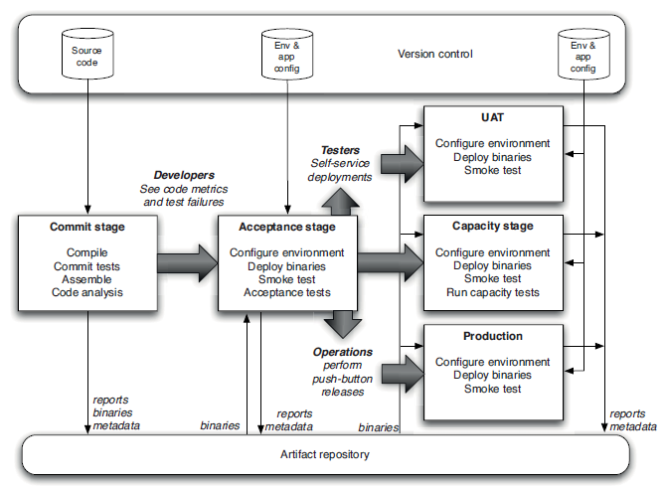
Basic Deployment Pipeline

Slide 30
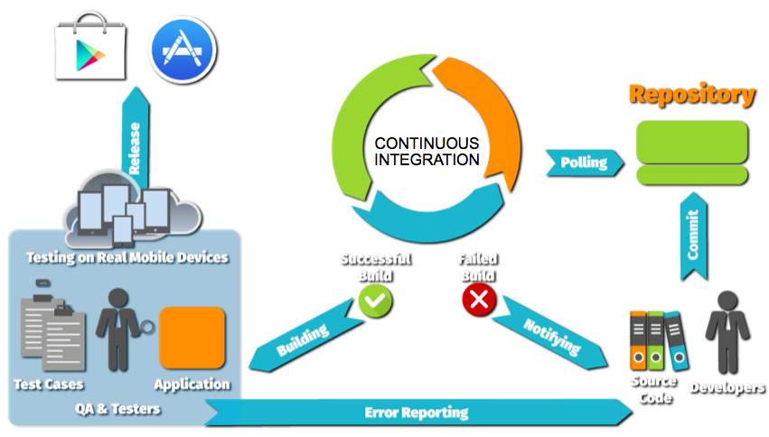
CI/CD Tools
https://www.jenkins.io/doc
https://github.com/features/actions
https://azure.microsoft.com/en-us/products/devops
https://circleci.com

Slide 31

Thank You & See You Again

